Slide 1




FlareGuard
Institutional-grade crypto risk operations dashboard and Chrome extension, built on Flare Network's cutting-edge infrastructure including FTSO V2 oracle feeds, FDC attestation concepts, and Smart Account simulations for automated risk management.

Slide 2


Hybrid Architecture Overview
Full-Screen Dashboard
MV3 Popup HUD
Dual Operating Modes
Comprehensive web interface at localhost:5173 with complete analytics, risk monitoring, and institutional-grade controls for DeFi operations management.
Compact 400×600 Chrome extension providing real-time risk gauge, favorite assets, liquidity shield status, and quick access to full dashboard.
Switch between Live mode (real FTSO V2 feeds on Flare Coston2) and Demo mode (scripted simulations with manual control panel for presentations).
Coverage spans blue-chip crypto assets including BTC, ETH, XRP, FLR, SOL, and USDC with customizable watchlists, comprehensive event logging, and automated liquidation protection controls.

Slide 3
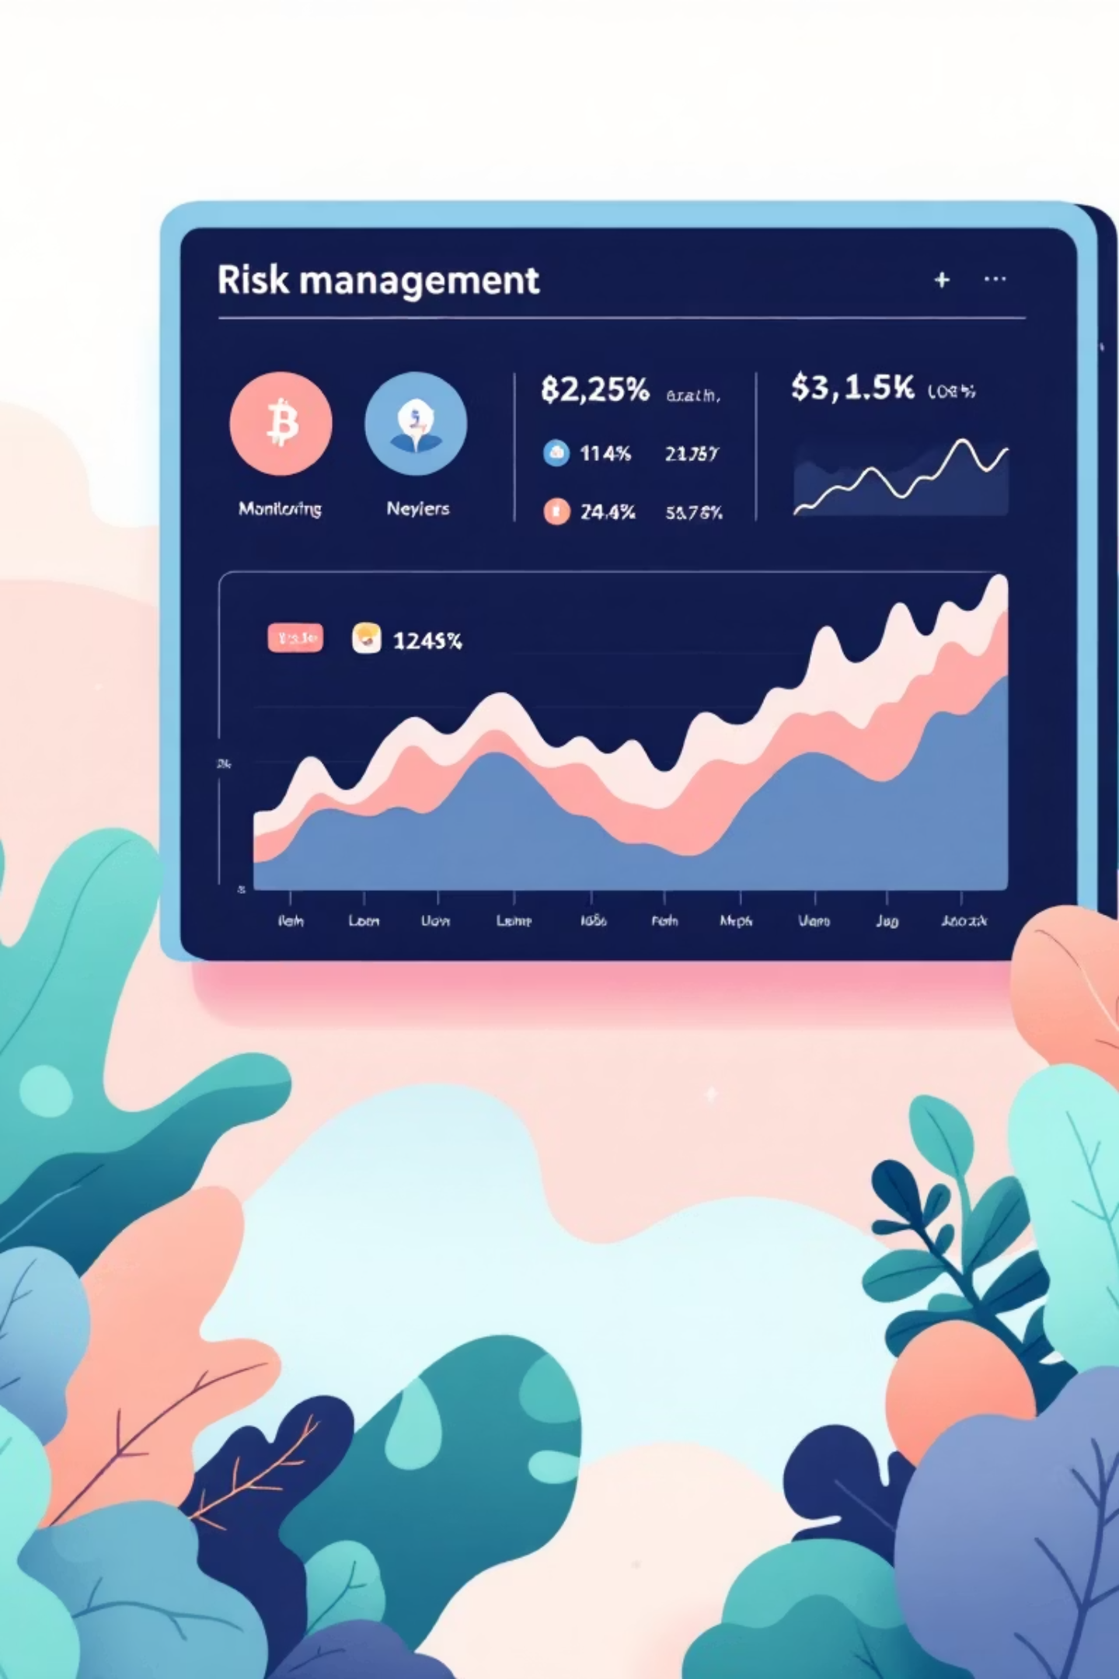
Core Feature Architecture
Live Data & Risk Intelligence
Simulation & Integration
FTSO V2 Live Feeds: Resilient RPC rotation with live heartbeat monitoring and real-time risk assessment tables
Smart Account Simulations: Automated proof generation and action logging when risk thresholds are breached
Risk Engine: Multi-factor analysis combining volatility metrics, volume pressure indicators, and pump detection signals
Demo Control Panel: Manual event triggering for market crashes, risk spikes, and scripted scenario replay
Liquidation Shield: Automated protection toggle with emergency withdrawal controls and complete audit trail
Wallet Integration: MetaMask detection with network enforcement and instant FLR balance synchronization

Slide 4
Extension Capabilities
01
02
Popup HUD Interface
Background Service Worker
Streamlined 400×600 layout displaying favorite assets, unified risk gauge, liquidity shield status indicator, and direct dashboard launch button.
Autonomous monitoring with dynamic badge text and color based on current risk levels, minute-interval alarms, and extensible alert hooks.
03
04
Unified Persistence Layer
Institutional UX Standards
useExtensionStorage hook maintains wallet addresses, watchlist preferences, and auto-protect settings synchronized across web dashboard and chrome.storage.
Complete system logging, contextual alert toasts, asset search functionality, live feed modal details, responsive layouts, and shadcn/ui components.

Slide 5


Flare Network Integration
FTSO V2 Oracle Feeds
Direct on-chain oracle integration via ftsoService.ts using ethers v6, delivering trustless price data with sub-second latency and automatic RPC failover.
FDC Attestation (Simulated)
Pre-trade proof verification implementing FDC-style checks with comprehensive logging in custom hooks, demonstrating compliance-ready attestation workflows.
Smart Accounts (Simulated)
Automated rebalancing and collateral adjustment actions triggered when risk crosses configurable thresholds, with full transaction simulation and audit trails.
FAssets Bridge Monitor
Real-time divergence tracking between native BTC and wrapped FBTC to identify bridge risk exposure and potential depegging events before they impact positions.
Architecture Philosophy: Client-side analytics consume trustless oracle data without on-chain writes, optimizing for speed, minimizing gas costs, and preserving user privacy.

Slide 6
Technical Stack & Risk Model
Technology Foundation
Risk Scoring Algorithm
Frontend: React 19 with TypeScript, Tailwind v4, and shadcn/ui components for institutional-grade interfaces.
Multi-signal risk engine combining three core indicators:
Volatility Signal (40% weight): Price variance normalized to 0-100 scale
Data Layer: use-flare.ts orchestrates prices, wallet state, event logs, risk calculations, watchlist management, and smart account demos.
Volume Pressure (20% weight): EWMA of price movements relative to trading volume
Pump Probability (40% weight): RSI overheating, order book thinness, and volume-price divergence detection
Blockchain: ethers v6 BrowserProvider and JsonRpcProvider with automatic RPC fallback for maximum resilience.
Final risk score: (vol/100) × 0.4 + volumeSignal × 0.2 + pumpProb × 0.4, clamped to 0-1 range and displayed as 0-100 percentage.
Extension: MV3 popup, background service worker, and content script using Vite multi-entry build configuration.

Slide 7




Build, Deploy & Roadmap
Installation
Extension Setup
Future Development
Node 20+, npm 10+ required. Install dependencies with npm install, then launch development server or build production bundle.
Build with npm run build, load unpacked extension from dist/ folder in Chrome, and access popup HUD from toolbar icon.
Multi-tenant profiles with server persistence, webhook/Slack alerts, historical replay with oracle snapshots, and real on-chain automation.
Key Commands
npm run dev — Launch web dashboard at localhost:5173
npm run build — Generate production bundle with multi-entry support
npm run preview — Serve production build locally for testing
npm run lint — Execute code quality checks
Network Requirements: MetaMask with Flare Mainnet (chain ID 14) or Coston2 Testnet (chain ID 114). Automatic network switching enforced on wallet connection.
MIT Licensed — Open source project encouraging community contributions and institutional adoption.

